Slide 1
FuzzyPSM: A New Password Strength
Meter Using Fuzzy Probabilistic
Context-Free Grammars
Ding Wang
Peking University
Debiao He
WuhanUniversity
Haibo Cheng, Ping Wang
Peking University
Notes:
Good morning everyone.
My name is Haibo Cheng, I am from Peking University, in Beijing, China.
Today, on behalf of our team, I am honored to have the opportunity to present our recent work, called “FuzzyPSM: A New Password Strength Meter Using Fuzzy Probabilistic Context-Free Grammars”, a study on the security of human passwords.

Slide 2
Outline
The problem
Our approach
  A user survey
  A large-scale empirical analysis
  A new password strength meter
Experimental results
  Ideal cases
  Real-world cases
  Cross-language cases
  Conclusion
Notes:
This is the outline of today’s presentation, the problem, our approach, experimental results, conclusion.

Slide 3
Outline
The problem
Our approach
  A user survey
  A large-scale empirical analysis
  A new PSM
Experimental results
  Ideal cases
  Real-world cases
  Cross-language cases
  Conclusion
Notes:
First, The problem.

Slide 4


Password authentication
Password authentication is everywhere
Notes:
No one doubts that passwords are the most prevalent |ˈprevələnt| authentication method for user authentication in today’s cyber world.

Slide 5
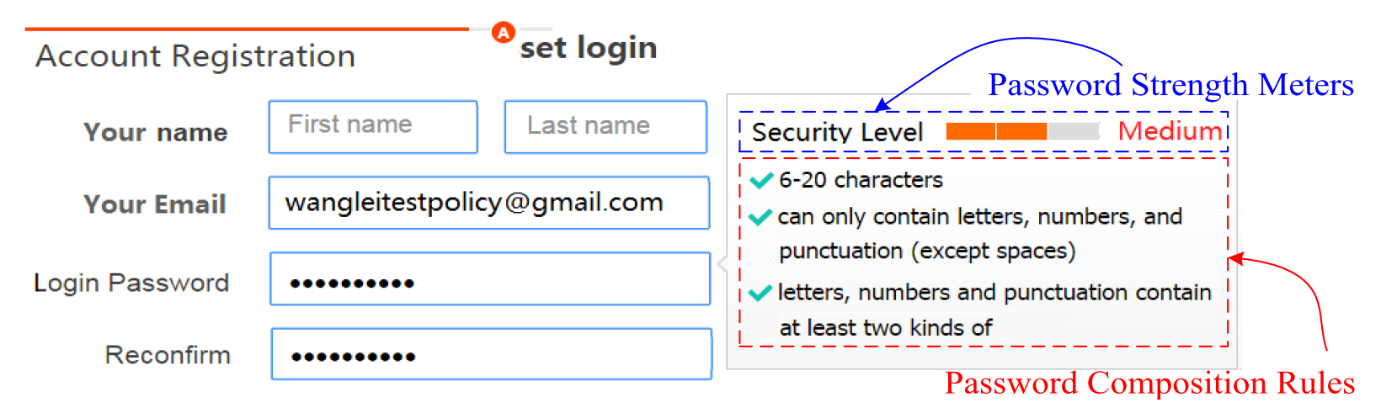
Password registration
Password registration is everywhere
PSM: Password strength meter
Notes:
When a user register on a website, the website requires an email or a username and a password.
Usually, website has some restrictions for password, this website require length from 6 to 20. Those restrictions |rɪˈstrɪkʃn| are password composition rules.
单击
Besides that, website also use a progress bar to show the strength of password. Like this one. With the password strength meter abbreviated |əˈbriːvɪeɪt| as PSM, user can choose a proper password for the website, not too weak to be cracked, and not too complicated to be forgot.

Slide 6
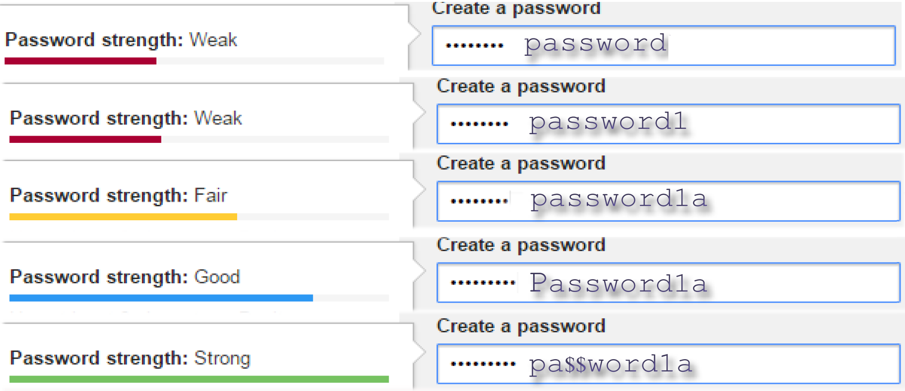
PSMs from the wild
Google’s PSM
Notes:
Let’s see some websites’ PSM.
This is google’s PSM. “password” is weak.
Add a digit number “1”, still weak.
Add another letter “a”, become fair.
Capitalize the first letter, become good.
Change the letter “s” to the symbol “$”, the password become strong.

Slide 7
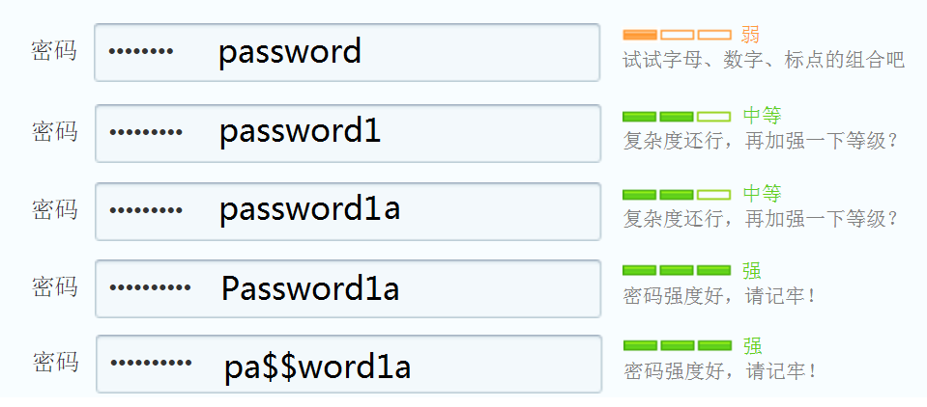
PSMs from the wild(2)
QQ’s PSM
Notes:
This is a Chinses website, QQ, the most popluar social website in China, like Facebook in America.
The result is as the same as google’s PSM.
These results are intuitive.

Slide 8
Some results about existing PSMs
Bad news
  Existing PSMs are inaccurate, illogical, inconsistent
(ESORIC’15, NDSS’14)
  Lead to: user confusion, fatigue, distrust
  (SOUPS’15, HAS’13)
Good news
Well-designed PSMs do help improve user
password practice.(SOUPS’15, CHI’13, IEEE S&P’12)
Notes:
But how accurate are those PSMs?
We have some bad news.
Existing PSMs are inaccurate, illogical, inconsistent.
Those lead to user confusion, fatigue |fəˈtiːg|, and distrust.
We also have some good news. Well-designed PSMs do help improve user password practice.

Slide 9
A Real-world problem
How to measure the strength of
human-chosen passwords？
Notes:
Altough existing PSMs are inaccurate, we get a real-world problem, “how to measure the strength of human-chosen passwords?”

Slide 10
Outline
The problem
Our approach
  A user survey
  A large-scale empirical analysis
  A new PSM
Experimental results
  Ideal cases
  Real-world cases
  Cross-language cases
  Conclusion

Slide 11
Our approach——user survey
Survey questions available at
http://www.sojump.com/jq/6443561.aspx(Chinese version)
http://www.sojump.com/jq/7005139.aspx (English version)
Aim to reveal user password creation behaviors
442 effective responses from China
35 questions
Notes:
To answer the question, we made a survey on how users create their passwords. This survey contains 35 questions in all.
We send this survey to our friends and classmates, ask them to fill in the questions, and ask them to send the survey to their friends.
Finally, we get 442 effective responses.

Slide 12
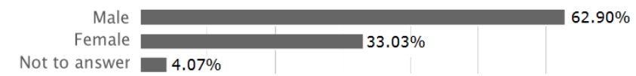
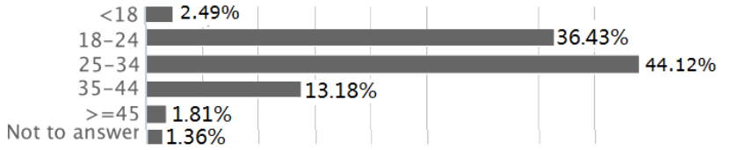
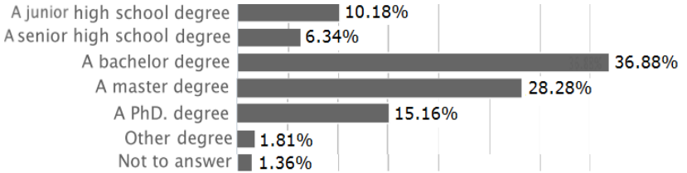
Demographic information
Gender
Age
Education
Participants are younger and get higher education than normal users.
Their passwords may be stronger. If they make some mistakes on password, normal user may make more mistakes.
Notes:
The participants are not sample from all Chinese website users. So the result is biased.
The participants of our survey are younger and get higher education.
So participants may be more familiar with Internet, their passwords may be stronger. If they make some mistakes on password, normal user may make more mistakes.

Slide 13
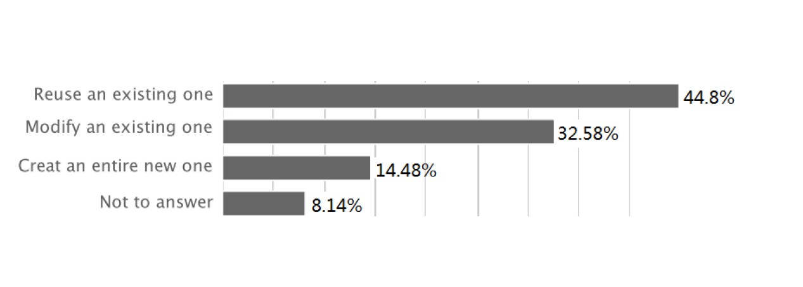
Survey results （1）
How do you create a password of an email account that will be frequently used?
77% users reuse or modify an existing password
Notes:
On the Internet, email is the most basic account. Some websites require the users provide email as username.
So the password of email is one of the most important password.
In our survey, we ask the participants how do you create a password of an email account that will be frequently used?
77% participants reuse or modify an existing one.

Slide 14
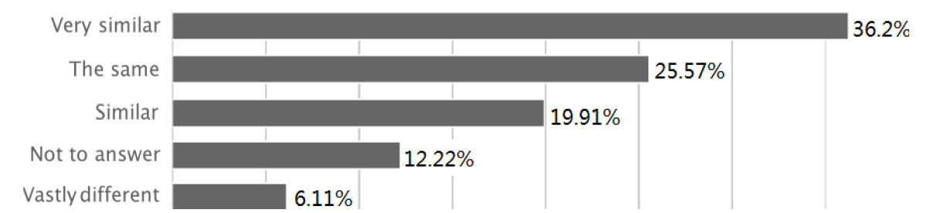
Survey results （2）
How do you describe the similarities between the new password and the existing one?
60% are the same/ very similar;
20% are similar.
Notes:
Next we ask how similarities between the new password and the existing one?
60% are the same or very similar; 20% are simliar.

Slide 15
Reveal an issue in existing PSMs
Our survey shows that, most users reuse or modify an existing password when registering a new account.
Existing PSMs (e.g., PCFG-based, Markov-based, NIST, KeePSM) assumes that users create passwords from scratch when registering a new account.
This, for the first time, explains why existing PSMs are not effective.
Notes:
Our survey shows that, most users reuse or modify an existing password when registering a new account.
Existing PSMs all assumes |əˈsjuːm| that users create passwords from scratch |skrætʃ| when registering a new account.
This explains why existing PSMs are not effective.

Slide 16
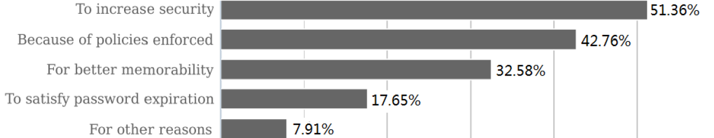
Survey results （3）
If you modify an existing password for the new email account, why?
50% are for increasing security;
43% are for the website policies；
Notes:
Next is “why do you modify your existing password?”
About 50% are for increasing security.
In recent years in China, a lot of websites were hacked and their databases containing users’ passwords were leaked. Some databases even stored users’ passwords in plain text. So in China, users become more concerned about security.
43% users modify for the website policies.
Different websites usually have different policies. Some websites require at least one symbol character, but some websites require password only consist of letter and number. So user need to modify his existing password.

Slide 17
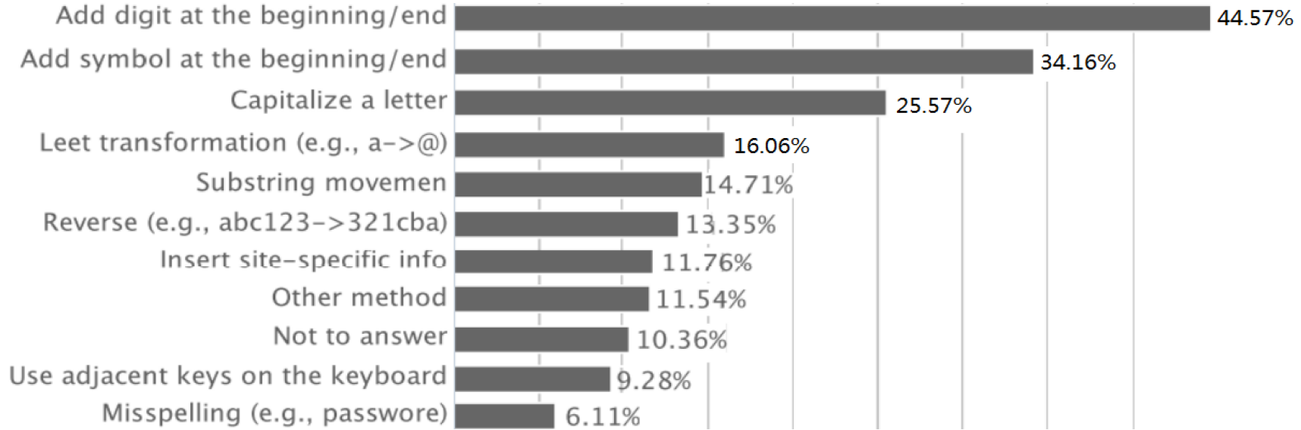
Survey results （4）
If you modify an existing password for the new email account, which transformation rules do you use?
Notes:
Next is how they modify their passwords.
Which trasformation rules are used?
44% users add digit at the beginning or end, 34% add symbol, 25% capitliaze a letter.
Some users like to use leet transformation, like “a” become a symbol “@”, letter “o” become a number “0”.

Slide 18
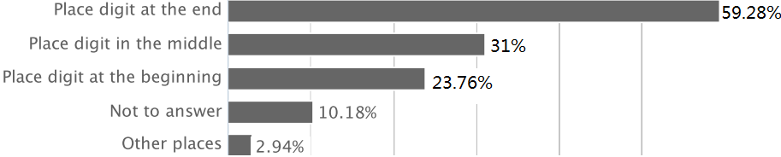
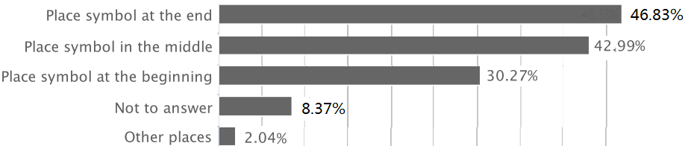
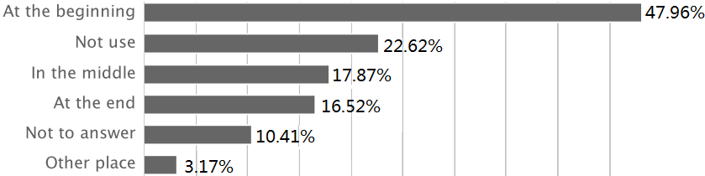
Survey results （5）
User behaviors are predictable
Where you place?
Dight
Symbol
Capitalization
Notes:
Next is “If the website requires that the password shall include a digit, a symbol, or a upper-case letter, where do you place it?”
About a half users place at the end.

Slide 19
Outline
The problem
Our approach
  A user survey
  A large-scale empirical analysis
  A new PSM
Experimental results
  Ideal cases
  Real-world cases
  Cross-language cases
  Conclusion
Notes:
After the user survey, let’s take a look at real-world passwords.

Slide 20
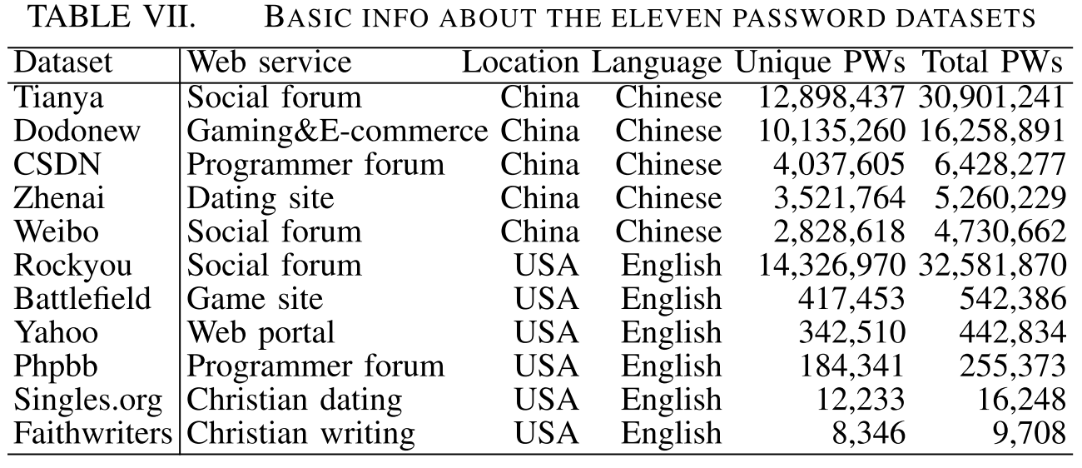
A large-scale analysis of real-world passwords
11 real-word password datasets
Notes:
There are 11 real-world password datasets. Five Chinese webstite, six english websites.
Tianya used to be the most popular social forum |ˈfɔːrəm| in China. In the dataset, there are 30 million passwords. CSDN is a programmer forum. Zhenai is a dating site. Weibo is the most popular social website right now in China.
Rockyou is the largest English dataset storing passwords in plain text. There are about 30 million passwords.

Slide 21
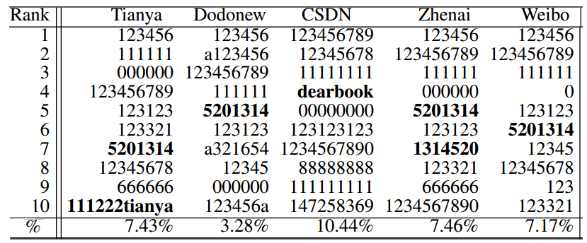
A large-scale analysis of real-world passwords (2)
Top-10 passwords
Notes:
This table show the most 10 popular passwords in the Chinese datasets.
The password “5201314” is an interesting password. In Chinses, it sounds like “我爱你一生一世”, meaning “I love you forever”.

Slide 22
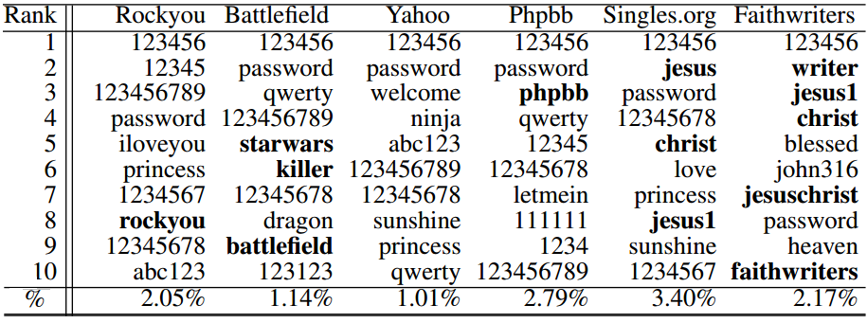
A large-scale analysis of real-world passwords (2)
Top-10 passwords
Notes:
This is the table of English datasets.
The last two dataset are from Christian website. Most users are Christian.
They prefer to use “jesus” and “christ” as their passwords.
There are another interesting phenomenon. Some users like to use the name of website as their passwords.

Slide 23
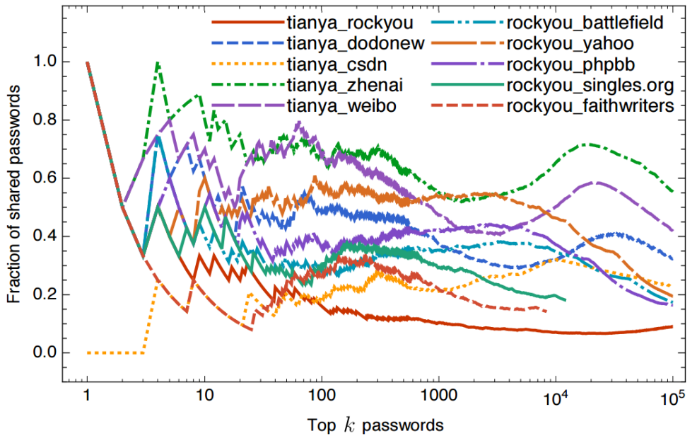
A large-scale analysis of real-world passwords (3)
Password overlaps between two sites
Notes:
Users on different websites perfer different passwords.
This figure shows the fraction of popular passwords shared between two sites.
The point (x,y) on the curves mean the most popular x passwords of the two sites only have y percent in common.
The fraction from different languages is much lower than that from the same language.

Slide 24
Summary of our empirical analysis
Conclusion：
Password distribution of different websites are very different.
Factors：Language、Service type、Faith、
Password policy、Time
Enlightenment：
1) PSM should depend on website；
2) PSM should be adapted as the number of users increases.
Adaptive PSM
Notes:
Let me give a summary of our empirical analysis.
Passwords distribution of different websites are very different.
Language, service type, faith, password policy and time all influence the distribution of passwords.
So PSM should depend on websites and should be adapted as the number of users increases.
Adaptive PSM is needed.

Slide 25
Outline
The problem
Our approach
  A user survey
  A large-scale empirical analysis
  A new PSM
Experimental results
  Ideal cases
  Real-world cases
  Cross-language cases
  Conclusion
Notes:
Then we introduce our new PSM.

Slide 26
Comparison of existing PSMs
Five Leading PSMs:
Academia: PCFG-based PSM (ACSAC’12)
Markov-based PSM (NDSS’12)
Industry: Zxcvbn (Dropbox, Wordpress)
KeePSM (Keepass)
Standards organization:
NIST-800-63-2 2013
Notes:
First, we make a comparison of five leading PSMs.
Two from academia. Two from industry, one from standards organization.

Slide 27
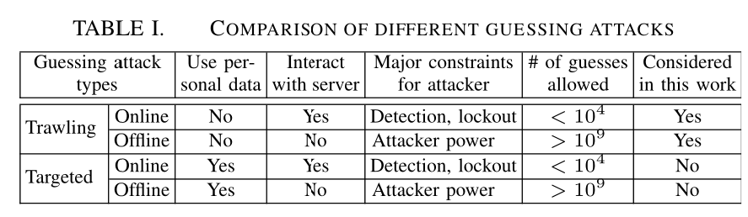
Security model
Notes:
There are two kinds of guessing attack, trawling attack and targeted attack. Targeted attackers know users’ personal data, like name or birthday, but trawling attackers don’t know. In this paper, we just consider trawling attack.

Slide 28
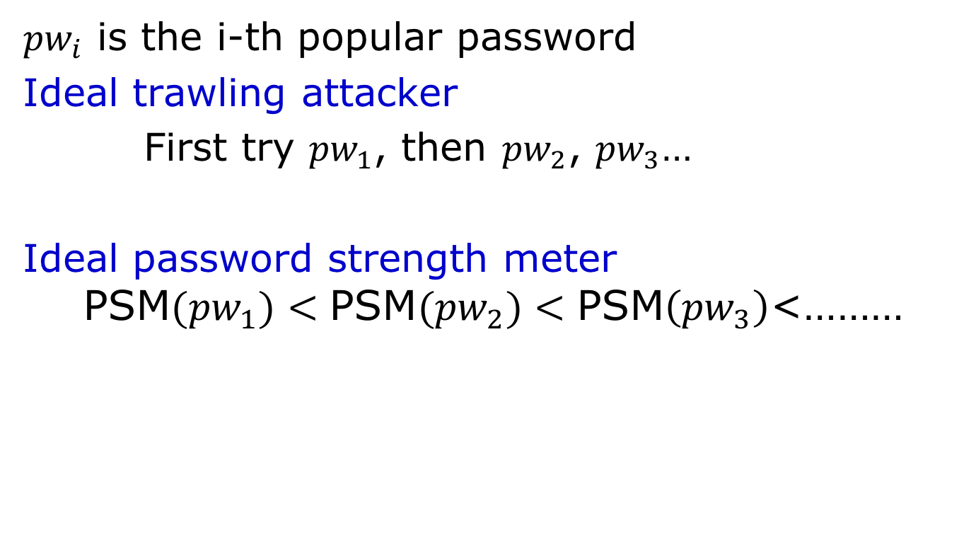
Ideal PSM
${pw}_{i}$ is the i-th popular password
Ideal trawling attacker
First try ${pw}_{1}$, then ${pw}_{2}$, ${pw}_{3}$…
Ideal password strength meter
$$\text{PSM}({pw}_{1})<\text{PSM}({pw}_{2})<\text{PSM}\left({pw}_{3}\right)\text{<………}$$
Notes:
The trawling attacker’s best strategy is to try the most popular password first, then the second one. With this method, the attacker can crack the most users with same guess number.
So the more popular a password is, the weaker it is.

Slide 29
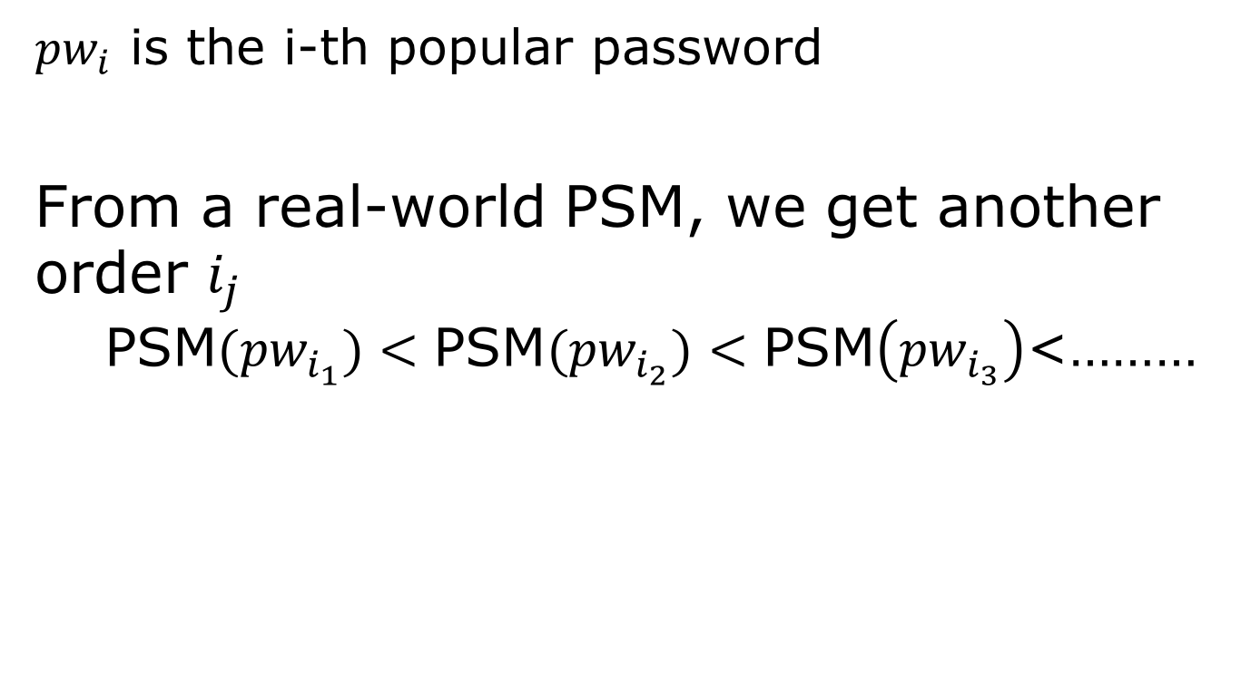
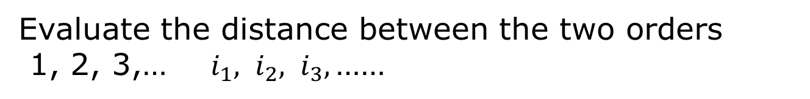
Accuracy of PSM
How to measure the accuracy of PSM:
${pw}_{i}$ is the i-th popular password
From a real-world PSM, we get another order $i_{j}$
$$\text{PSM}({pw}_{i_{1}})<\text{PSM}({pw}_{i_{2}})<\text{PSM}\left({pw}_{i_{3}}\right)\text{<………}$$
Evaluate the distance between the two orders
1, 2, 3,… $i_{1}{, i}_{2}, i_{3},\text{……}$
Notes:
How to measure the accuracy of PSM?
${pw}_{i}$ is the i-th popular password.
From a PSM, we get another order, the password strength increasing order.
This order of an ideal PSM is the same as the password popular decreasing order.
So we can use the distance between those two orders to measure a real-world PSM.

Slide 30
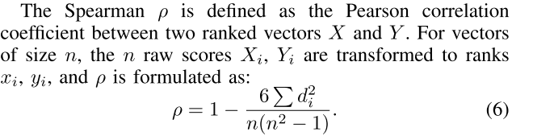
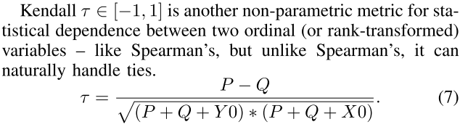
Accuracy of PSM
real numbers in [−1,1].
1 means same order,
-1 means inverse order
Spearman ρ
Kendall τ
Notes:
We use Kendall τ and Spearman ρ to measure the distance between those two orders.
These two coefficients are real number from minus one to one. One mean two orders are the same order. Minus one mean one order is the reverse of the other order.

Slide 31
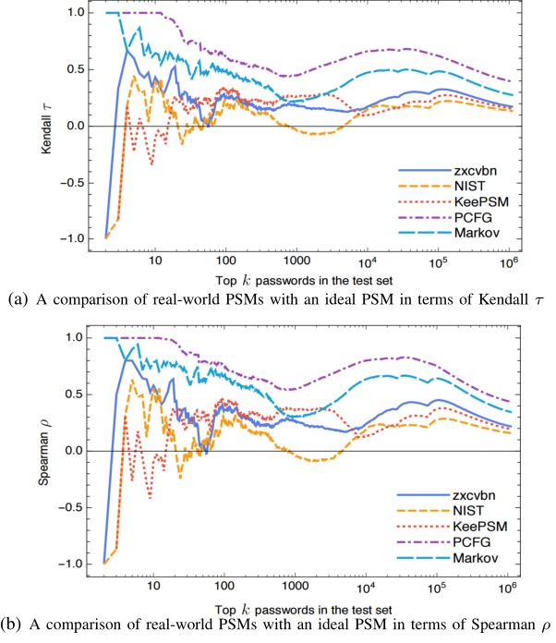
Accuracy of PSM
PSMs from academia:
PCFG-based is better than Markov-based.
PSMs from academia are better than PSMs from Industry
With proper training set, these PSMs can be used on Chinese web password.
Notes:
The figures show the experiment with 1/4 CSDN passwords for training and another 1/4 for testing.
We can see in these two PSMs from academia, PCFG is better than Markov.
PSMs from academia are better than PSMs from industry.
With proper training set, these PSMs can be used on Chinese web password.

Slide 32
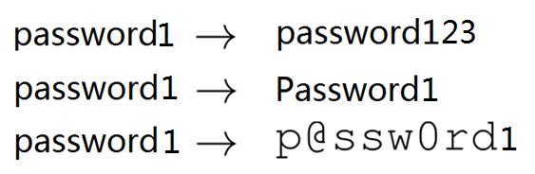
Our new PSM：
fuzzyPSM
Users reuse or slightly modify an existing password
Three methods of modifying:
Concatenation, Capitalization, Leet
PCFG: Probabilistic Context-free Grammar
Notes:
Then we propose our new PSM, fuzzyPSM.
When users create a new password, they like to reuse or slightly modify an existing password.
So our new PSM consider these three passwords are modified from the same password “password1”.
Our fuzzyPSM captures three methods of modifying: Concatenation |kənˌkætɪˈneɪʃn|, Capitalization and Leet

Slide 33
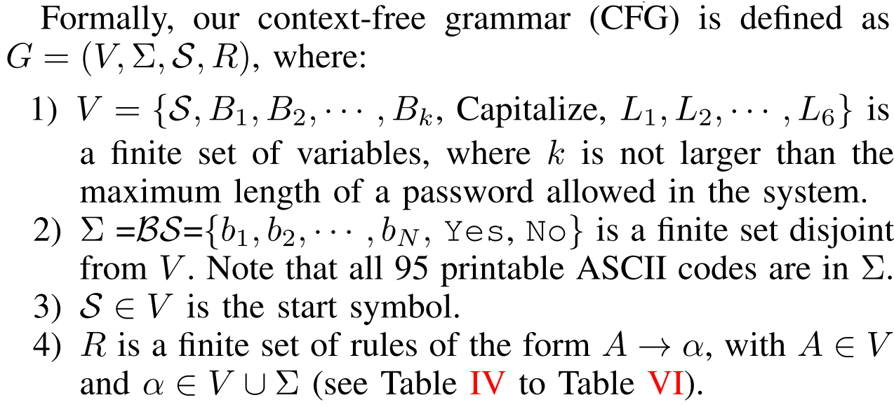
PCFG: Probabilistic Context-free Grammar
A context-free grammar G is defined by the 4-tuple:
(V, Σ, R, S)：
  Non-terminal character set V
  Terminal character set Σ
  Rule set R: a relation V→(V∪Σ)*
  Start symbol S
考虑三种修改方法:
Concatenation, Capitalization, Leet
基于概率上下文无关文法(PCFG)
PCFG: Probabilistic Context-free Grammar
Notes:
Fuzzy PSM is also a probabilistic context-free grammar.
This is the definistion of context-free grammar. Four tuple, Non-terminal character set V, Terminal character set Σ, the most important part, rule set R, is a relation from V to V union Σ star, and a Start symbol S.

Slide 34
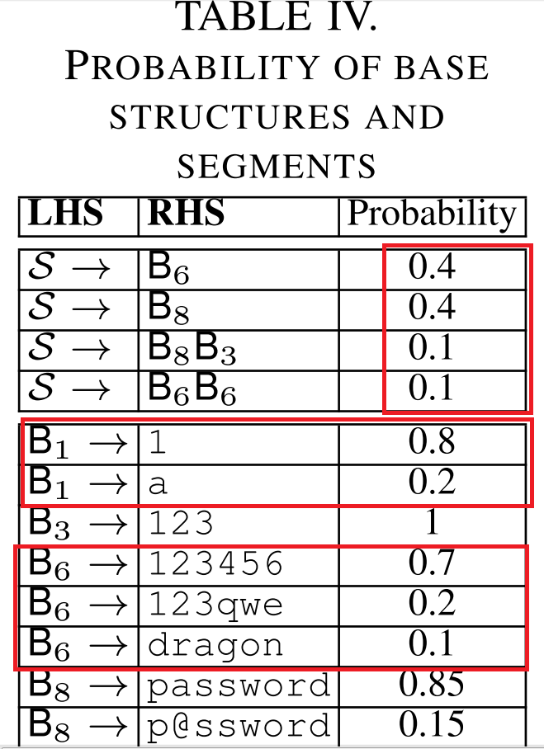
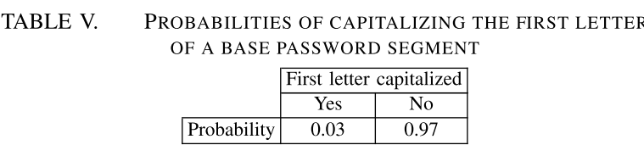
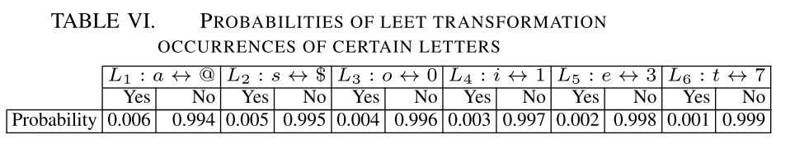
Our Fuzzy-PCFG
Probabilistic Context-free Grammar
With the real password set，we can get the probability of every rule α→ β.
Notes:
The probabilistic context-free grammar give every rule a probability in context-free grammar.
These probabilities we can get from the real password set.
This is an example.
The table on the left is probability of base structures and segments.
From this table, we can see the start symbol has 0.4 probability to become B8. B8 mean base passwords the length of which is 8. B8 has 0.85 probability to become “password”.
These two tables on the right are probabilities of capitalizing and leet transformation.
The old PCFG only have the first table, that’s the difference between our fuzzyPSM and PCFG-based PSM.

Slide 35
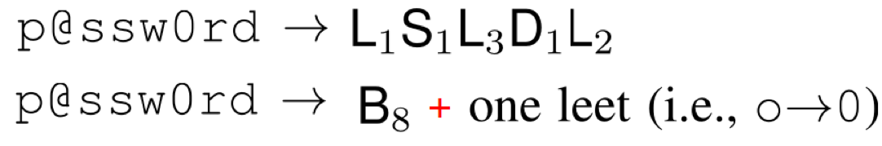
Characteristic of Our fuzzyPSM
Different from old PCFG(example)
Old PCFG:
FuzzyPSM:
Notes:
Let’s see an example.
This password “p@ssw0rd”, old PCFG consider it as a combination of five segements. Our fuzzy PSM consider it as a base password “p@ssword” and modify the letter “o” to the number “0”.

Slide 36
Our Fuzzy-PCFG
Why called“fuzzy”
Notes:
Why we call the new PSM “fuzzyPSM”?
First reason is over 80% items in the base structure table are of the form S->Bm.
Second reason is fuzzy logic aims to imitate |ˈɪmɪteɪt| the way human think and our PSM aims to imitate the way human create their passwords.

Slide 37
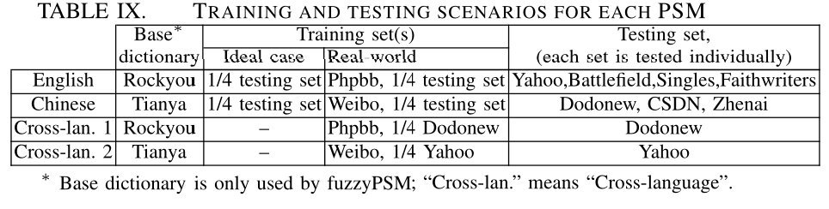
Experiments
Four scenarios
11 real password sets（97.4 Million real passwords）
36 Experiments
Notes:
Then we use the Kendall τ and Spearman ρ to measure the accuracy of our fuzzy PSM.
We design four scenarios |sɪˈnɑːrɪəʊ| and conduct 36 experiments with 11 real password sets.

Slide 38
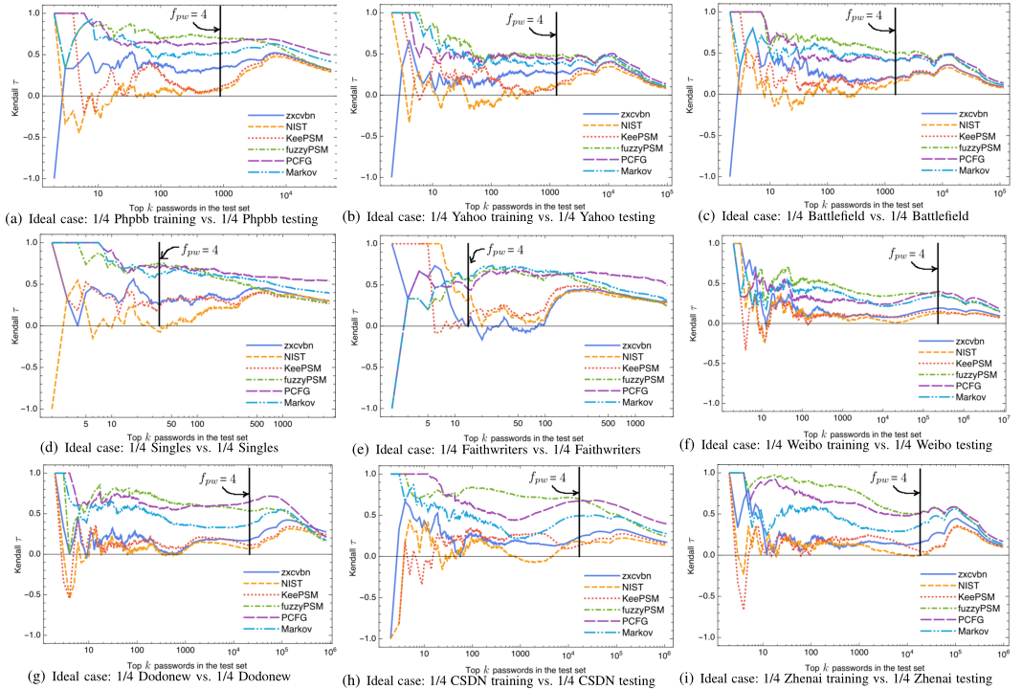
Experiments
fuzzyPSM outperforms existing ones
Notes:
We find fuzzy PSM outperforms existing ones.
单击
The green line is fuzzyPSM. Almost in every figure, green line is above other curves.

Slide 39
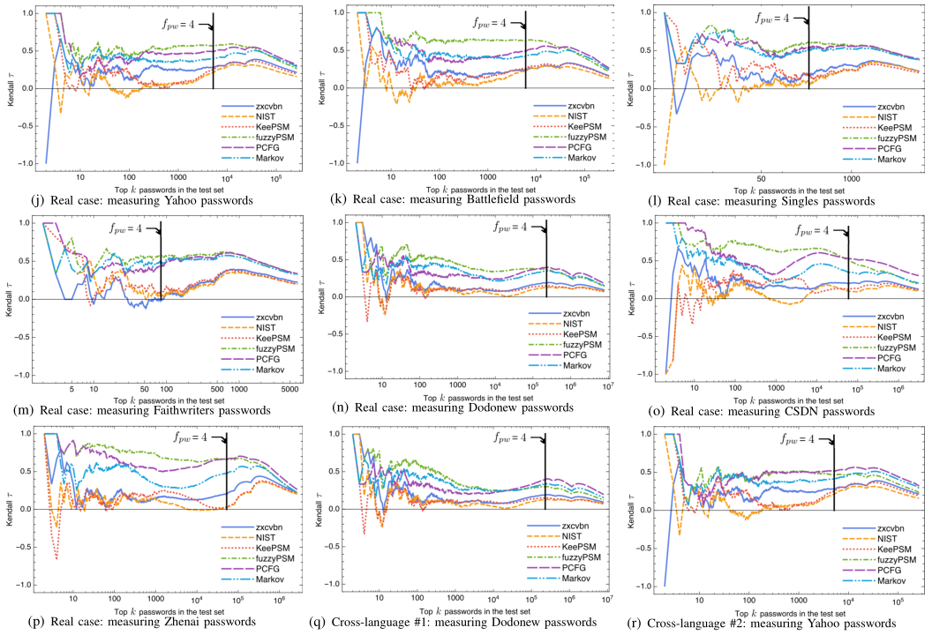
Notes:
Same results.

Slide 40
Conclusion:
PCFG is the best PSM from academia?
PSMs from academia are more accurate than PSMs from industry.
Those PSMs accurate for Chinese users with proper training set.
Considering users’ behavior, we propose a new meter—fuzzyPSM.
Notes:
To conclude
PCFG is the best PSM from academia?
PSMs from academia are more accurate than PSMs from industry.
Those PSMs accurate for Chinese users with proper training set.
Considering users’ behavior, we propose a new meter—fuzzyPSM.

Slide 41

THANK YOU & QUESTIONS
Notes:
That’s all. Thank you for your attention!

